Slide 1
WIFIOLOGY
To Illuminate The Current State Of Wireless Connectivity In Order To Inform And Optimize Users’ Networking Experience

Slide 2
Meet the Team
Baiyu Chen - Front End/ Selenium test
Peng Jiang - Front End
Ryan Campbell - Android
Robert Cope - Back end /node-js integration / 802.11 research / API / Swiss Army Knife
Jason Nguyen - Back end / email notification integration / API
Jasper Niemeyer - Project management, meeting minutes, milestones, initial heroku deployment, nodejs integration
Notes:
Everyone

Slide 3
Initial Idea, Motivation and Pivot
Wanted to know if certain study areas were crowded before trying to meet there
Use WiFi traffic to estimate the number of people in the vicinity of our listening device
This alone would have only really counted as one or two features + login
Add features to visualize and export data
With some additional work our app now has the potential to serve a broader commercial market giving network admins:
Monitor network traffic in real time
Compare to historical data of that network
Diagnose the health of network equipment
Identify suspicious mac addresses on the network
Notes:
Jason
We started at the initial idea, then we pivoted from a simple consumer based product to a product that can be sold to businesses to watch and analyze their internet as well. This is useful because it gives the businesses ideas on how they should market to their consumer base, and watch and protect their wifi network.

Slide 4
Project Management & Meetings
Met every week on Monday evenings
Used a Kanban process (this is little-a “agile”)
No sprints
Capacity to pick up tasks as they are created
Retrospectives at the beginning of each meeting
Task run down at the end of each meeting
Continuous Integration, Continuous Deployment - heroku, travis CI
Tasks managed using Trello
Great in the initial research phase
Became cumbersome towards the end of the project as tasks kept changing in scope
This might be less of a problem if we were more experienced and could better anticipate our requirements
Communication using Groupme
Notes:
Jasper

Slide 5
Challenges
Teamwork challenges:
Diverse range of experience among team members
Tech challenges
802.11 - Learning how to decipher 802.11 to give us what info we needed
Heroku DB limitations - Hobby mode had it’s limits
Modeling: What does busy mean?
With all the given data, how do we analyze it?
Node.js: It is hard for everybody to get start with
Not everyone is familiar with how to wield the async secret sauce.
Notes:
Peng

Slide 6
High Level Architecture
Users have many physical 802.11 listening devices with supported 802.11 card
Python listener node codebase sniffs 802.11 traffic, analyzes, caches in SQLite DB
Python listener code batch uploads from SQLite DB to central server
Upload via REST API (Swagger)
Node.JS central server in front of PostgreSQL database
All listener nodes, corresponding API keys, etc. tracked and registered here
Provides API for listener nodes to upload to, API for other consumers to utilize
OpenAPI 2.0/Swagger
Provides web frontend for monitoring, analysis
Android application (Java)
Utilizes central server REST API to provide native mobile data tracking and analysis
Notes:
Robert

Slide 7
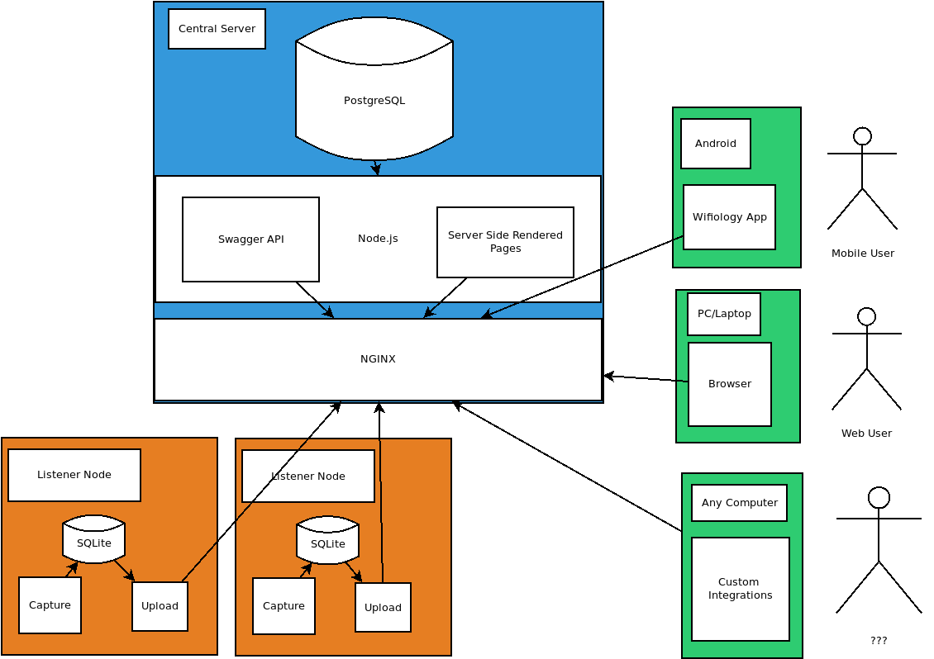
High Level Architecture (Cont.)
Notes:
Robert

Slide 8





















Tools (Not Exhaustive)

Slide 9
Tools, Languages & Resources Continued
Android App
Android Studio
Swagger Client
Java for Classes
XML for Layouts
Material.io
Volley
Operations
RamNode
Nginx
Pm2
Munin (Monitoring)
Central Server
NodeJS
ExpressJS
OpenAPI 2/Swagger
jQuery
Bootstrap 4
PostgreSQL 10+
Plpgsql & SQL
Mocha & Chai
Selenium
Listener Node
Python
Pcapy, Scapy, dpkt
requests
SQLite3
Unittest
Bottle
Eventlet
Notes:
Robert...don’t have to talk long

Slide 10
Coordination is challenging
Hard to keep up with scope
Hard to keep up with changes in requirements
Cards become deprecated as feature requirements changed
Process is new to most team members
Notes:
Jasper

Slide 11

Groupme
Overall rating: 3 stars for being useful + 1 star for not being slack
It’s a step up from SMS group messaging
Can’t create group DMs or unhide message threads
Webhhooks, Yay!
Used IFTTT to ping group anytime theres a pull request on github
Notes:
Jason

Slide 12

Overall rating: 2 Banana Peels out of a possible 5 stars
JS itself has gone through many evolutions
Easy to find bad examples online
Without prior knowledge of current best practices hard to know correct answer
Unfamiliar programming paradigm
Promises, callbacks and Async awaits are foreign to most students at this level
More difficult to learn than it first appeared
Notes:
Robert

Slide 13

Ramnode
Inexpensive virtual machines, good performance
Just a VM
Need to know how to provision a VM (securely) for a node app
Notes:
Robert

Slide 14

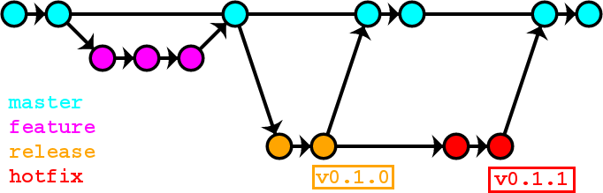
lkf
Overall rating, 3 out of 5 stars plus an avacado fella
Slight learning curve but relatively easy to manage
Gitflow workflow mode
Compartmentalization of code
team members working on different files to avoid merge conflicts
We used tags like pros :)
Notes:
Jasper

Slide 15
Overall rating: 2 stars
Easy to get set up and running
Nice CI tools, automatic build process and github integration
Free tier is way too limited for the size of our DB
Billing is deliberately opaque -> paid tier not ideal either
Could cost a company a lot of money if a dev’s were spinning up side projects on heroku at company expense. (an actual problem)
Could cost a hobby developer a lot if their app suddenly scales -> upside is that Heroku could in theory handle that scaling
UX is pure Bait & Switch
Monitoring and profiling
Notes:
Jasper

Slide 16

Overall rating 4 out 5 ‘SELECT * s
Excellent combination of traditional SQL + document DB features (like JSONB)
Migrations are easy (transactional DDL)
Easy integration with Heroku
Using plpqsql is only ok - hard to debug but makes queries look nice
SQLite was also used on client: Best swiss army knife ever
Notes:
Robert and Jason

Slide 17
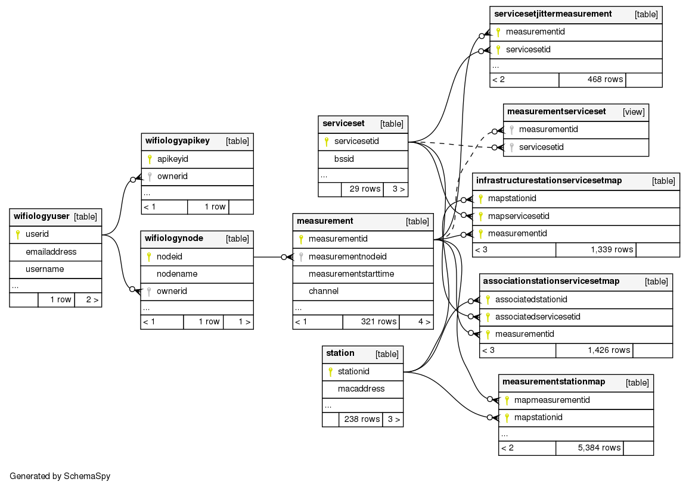
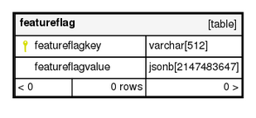
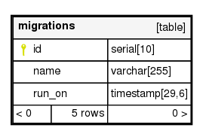
PostgreSQL Schema (NodeJS, Compact)

Slide 18
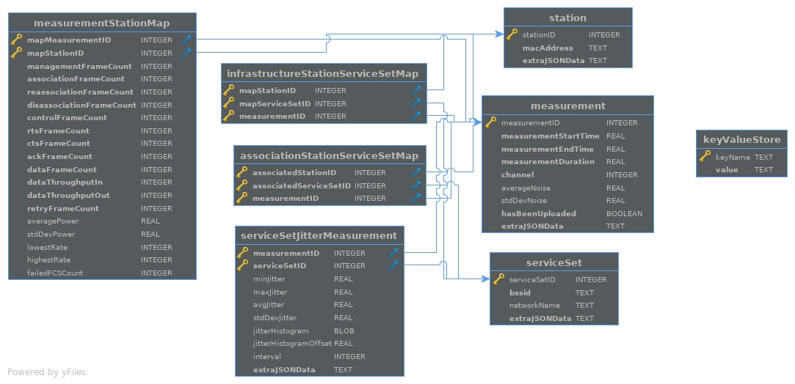
SQLite Schema

Slide 19

4.5 Sneks out of 5 Sneks
Easy for the team to pick up, good tooling and libraries
Slow at times when running on the Raspberry Pi
(Editorialization: Maybe Python instead of NodeJS for the class next time?)
Notes:
Jason

Slide 20


Swagger
Open Source Software Framework to help develop a RESTful API
Really easy and quick to produce an API to test and consume
Likely the future of almost all new REST APIs (makes REST less terrible)
Notes:
Ryan

Slide 21

Used on Linux in Chrome OS
Required terminal wizardry to get working (gradle -_-)
Randomly crashing for no reason
Otherwise solid, based on intellij & has the darcula theme
Ability to deploy on device was AMAZING
Normally testing done in emulator or over adb connection
Deployed from linux vm to android container in Chrome OS
Was instant, smooth, and consistent
App itself: Material Themeing, Volley HTTP Library, RecyclerViews
Notes:
Ryan

Slide 22
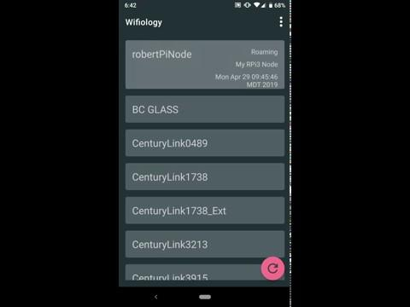
Android Demo
Notes:
Ryan

Slide 23

Frontend
Deciding the theme. It has to be cool, easy to read and user-friendly
All in one page including login and register at first
The web page contains too many junk javascript and css files and it is hard to cooperate with backend
Get rid of the all-in-one page and start over again with a concise looking
Give me a
<br>
Notes:
Peng

Slide 24
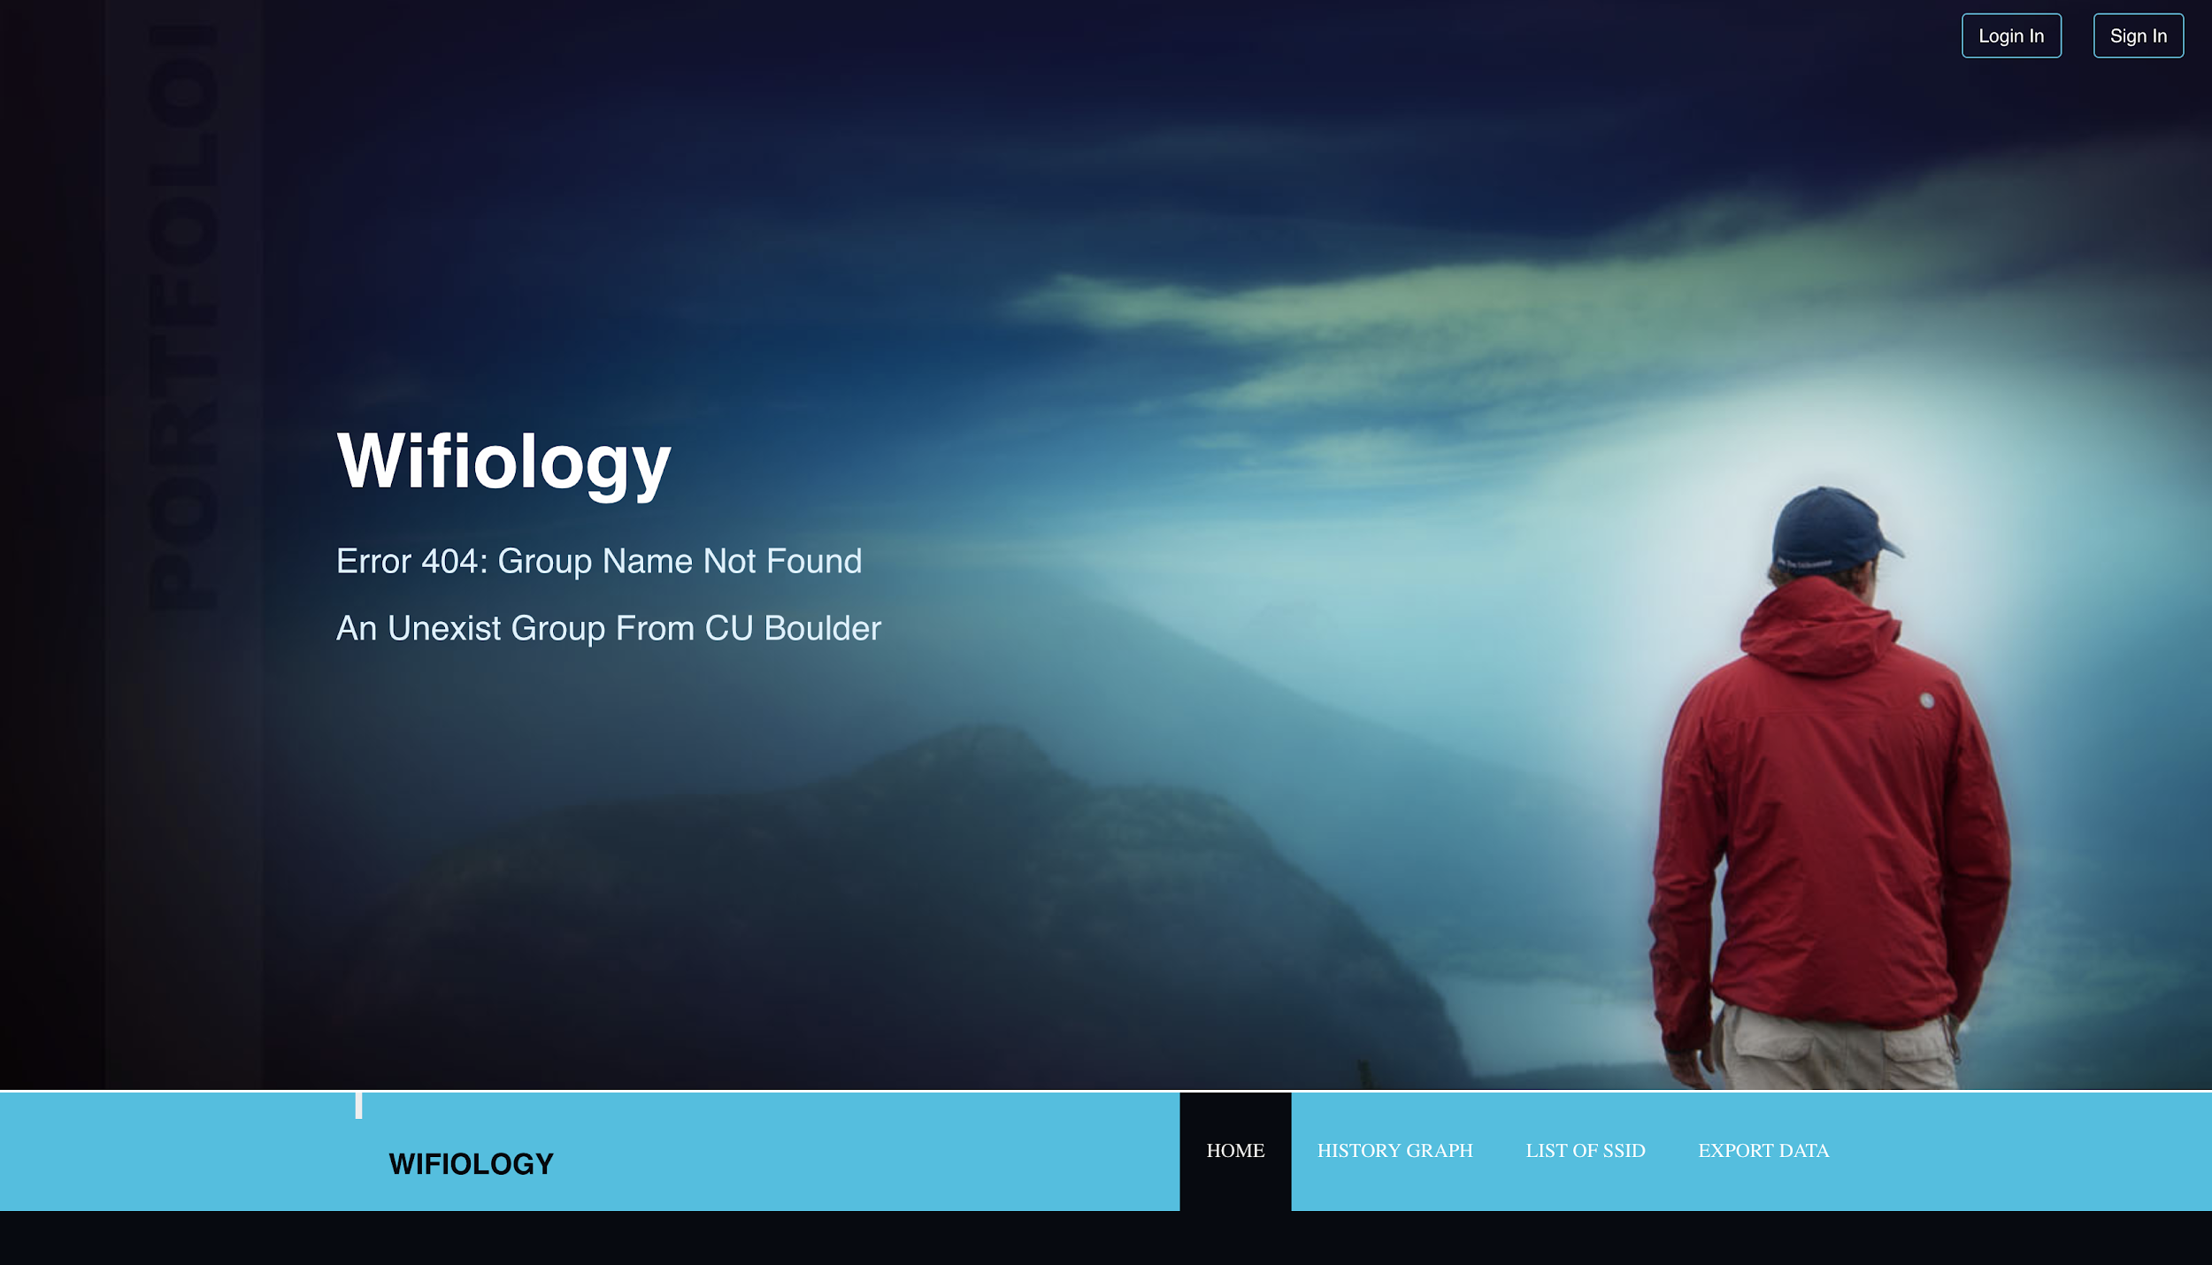
Notes:
Peng

Slide 25
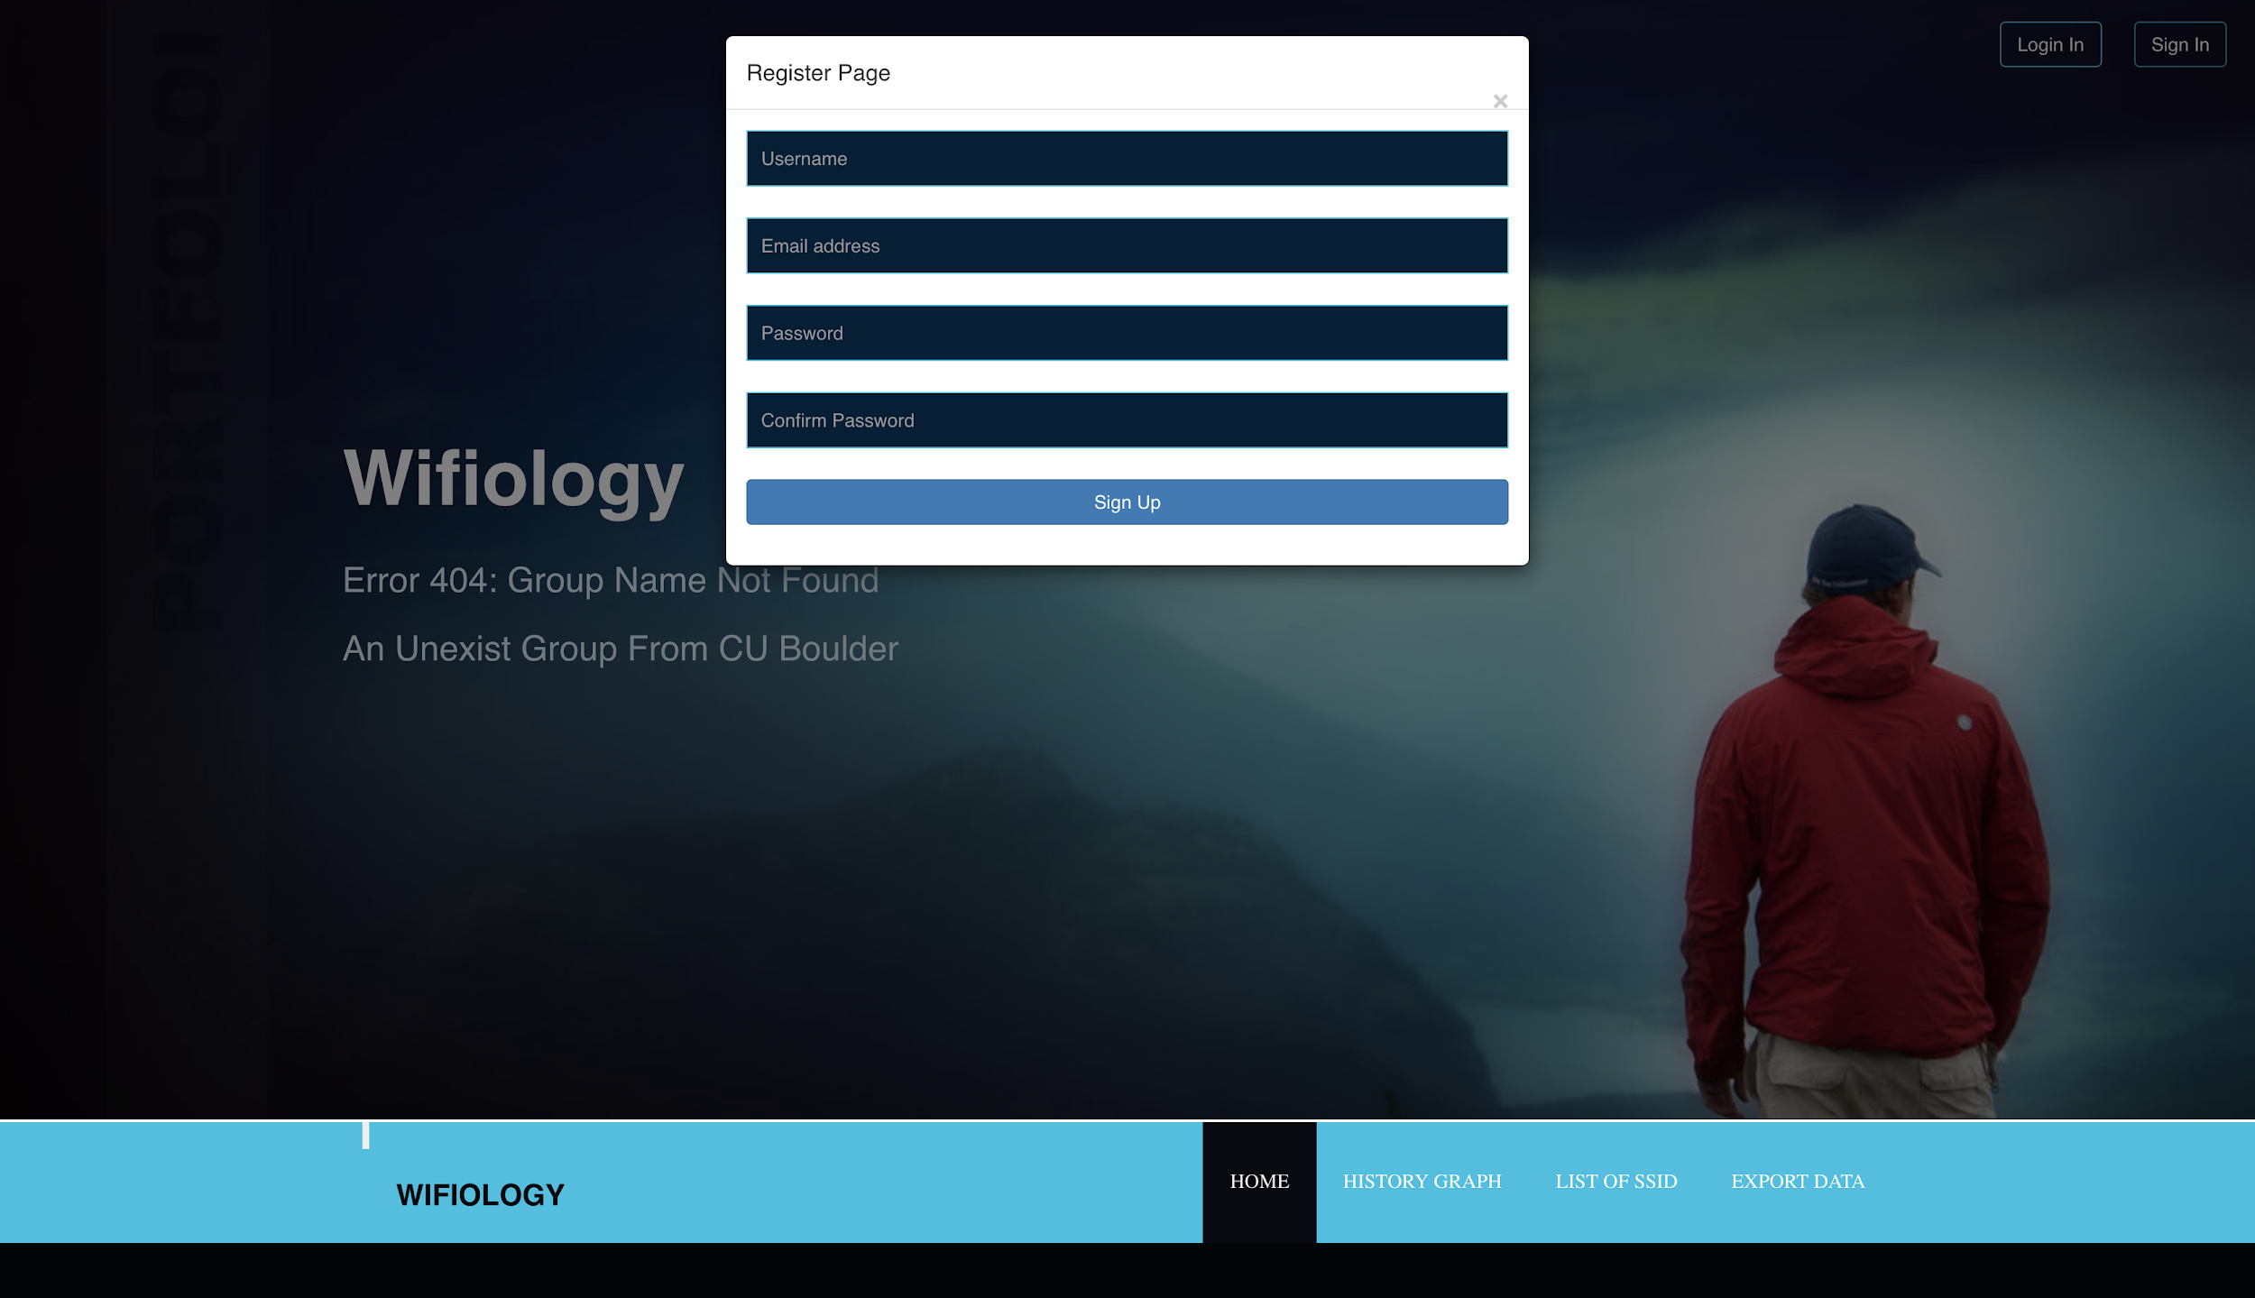
Notes:
Peng

Slide 26

Selenium Automation Testing
Selenium provide many tools to test the webpage automatically.
We use selenium to test the register, login and logout function.
Testing process :
Selenium automatically control the web browser to open our website
Click the register button and go to the register page
Fill the information and click the register button to create a new account
Log out
Use the new account to login to our website
Test done
All testing process are running automatically!
Notes:
Baiyu

Slide 27
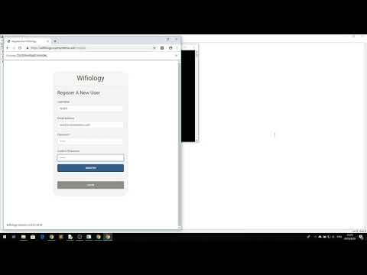
Selenium Automation Testing

Slide 28
Website Demo
https://wifiology.copesystems.com/
Notes:
Robert

Slide 29
Next Steps
More analysis on the central server
Easier listener node configuration
Active probing
Better multi tenancy
Easy hardware package for listener node
Convert listener node to C/C++/??? (Performance)

Slide 30
References Used (802.11)
“802.11 Wireless Networks: The Definitive Guide, 2nd Ed.”, Gast
“Next Generation Wireless Lans: Throughput, Robustness, and Reliability in 802.11n”, Perahia and Stacey
“Identifying Channel Saturation in Wi-Fi Networks via Passive Monitoring of IEEE 802.11 Beacon Jitter”, Molina, Blac, Montavont, Simić
“Mrc-cciew” (https://mrncciew.com)

Slide 31
Backup Slides
ONLY IF NEEDED

Slide 32
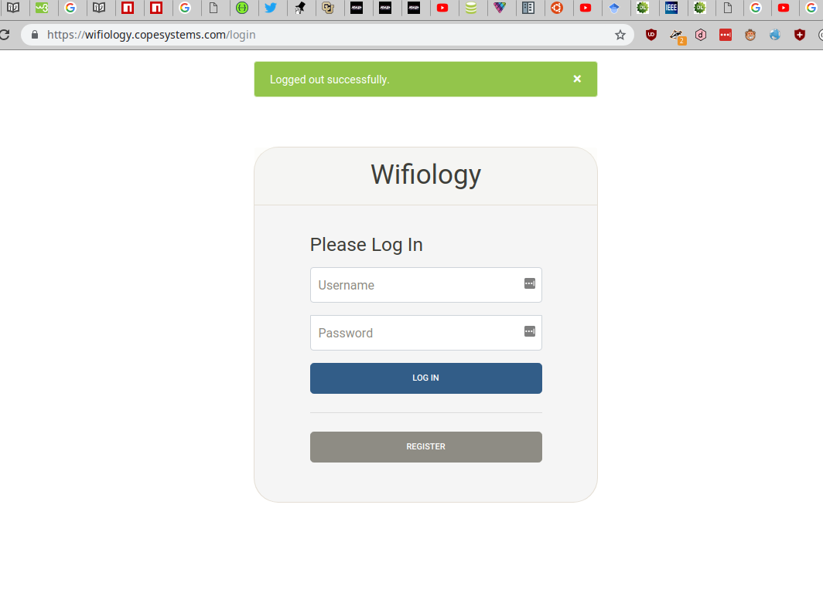
Website

Slide 33
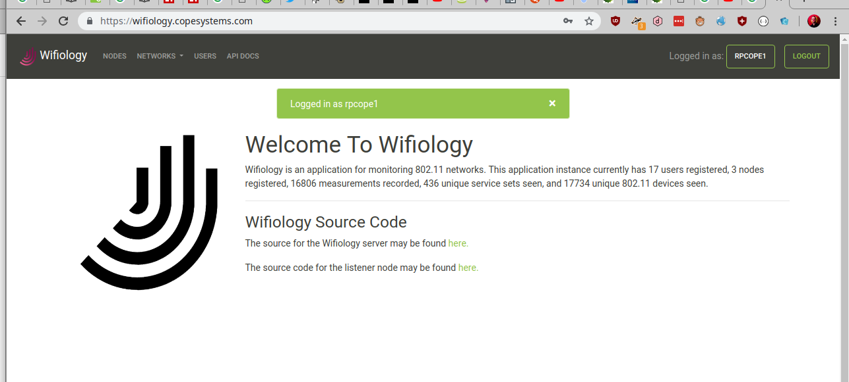
Website

Slide 34
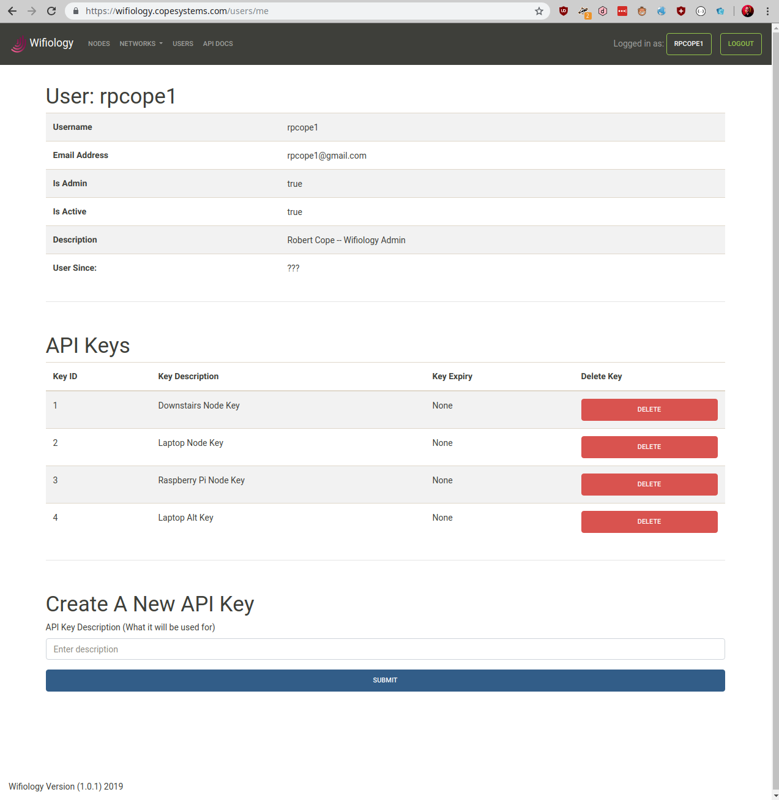
Website

Slide 35
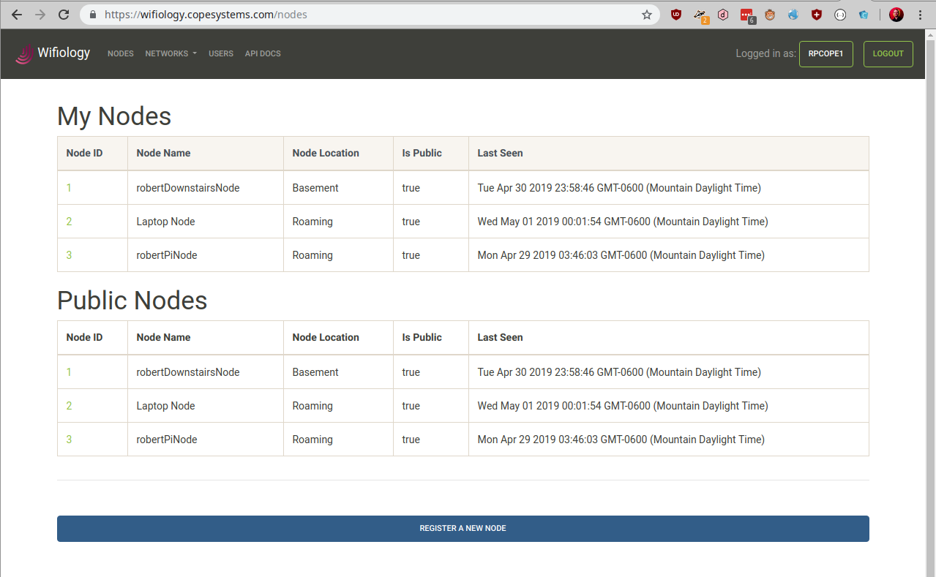
Website

Slide 36
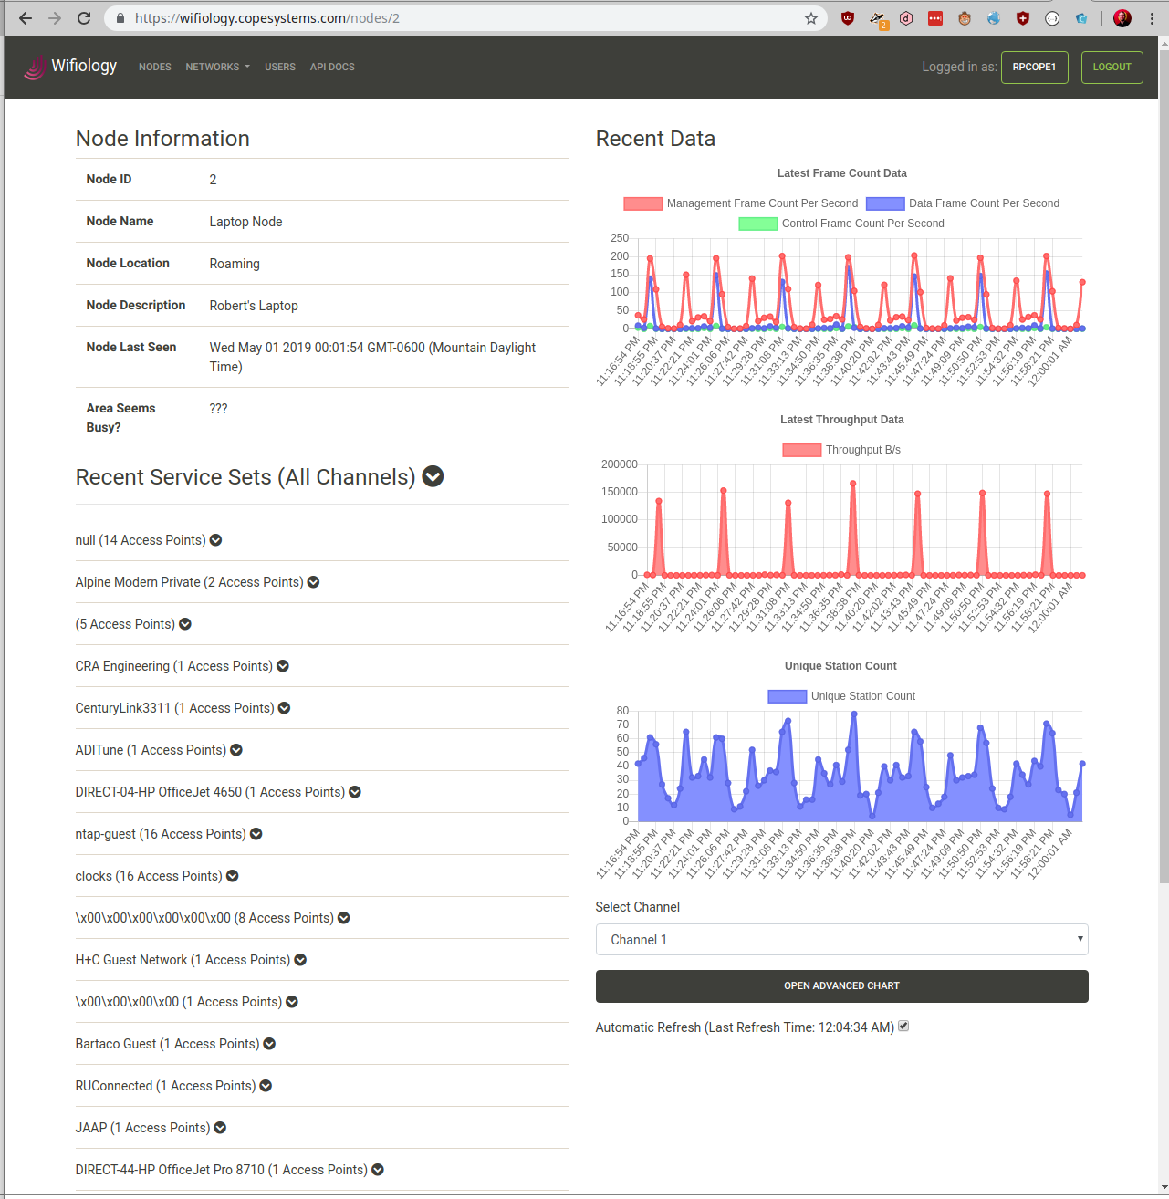
Website

Slide 37
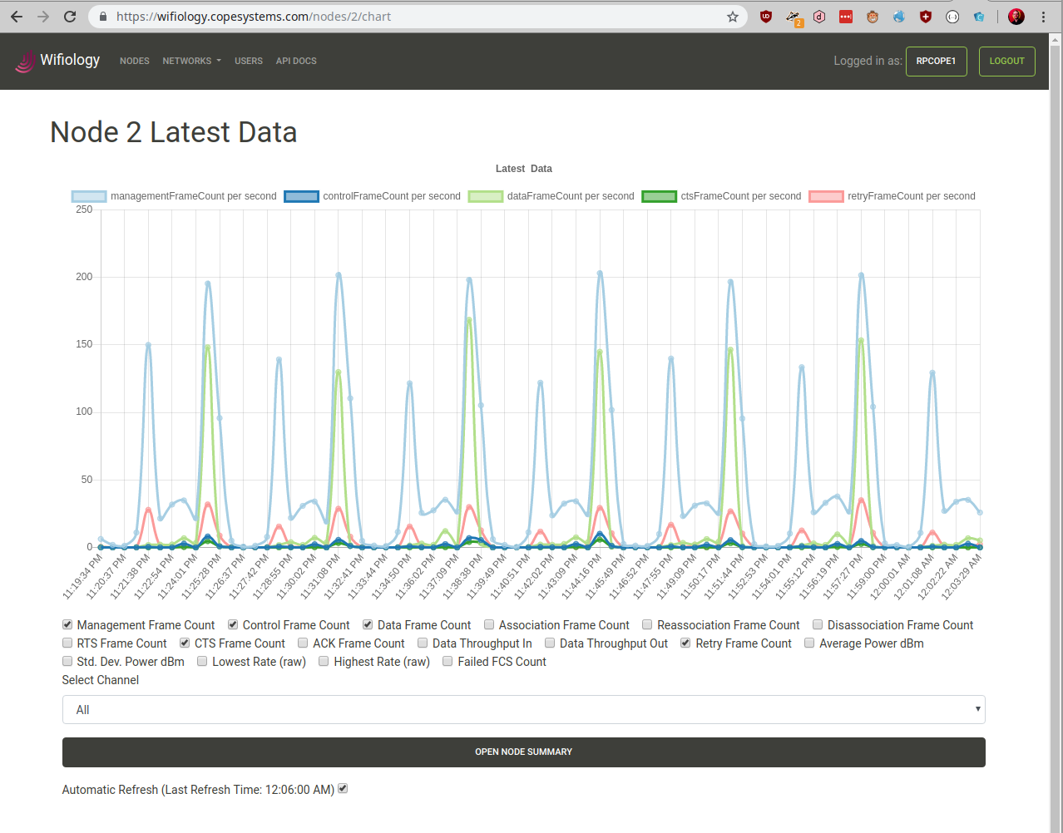
Website

Slide 38
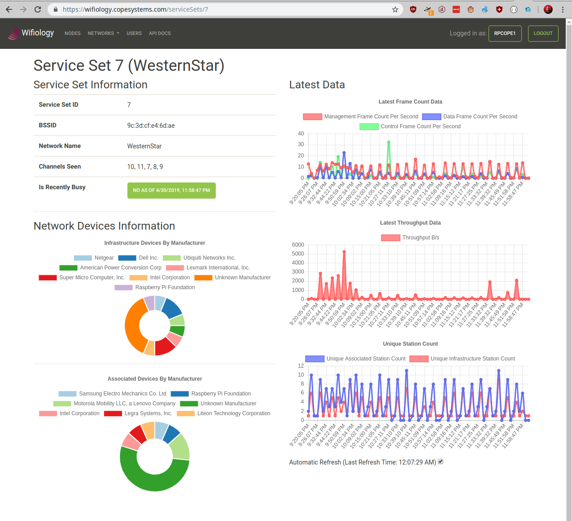
Website

Slide 39
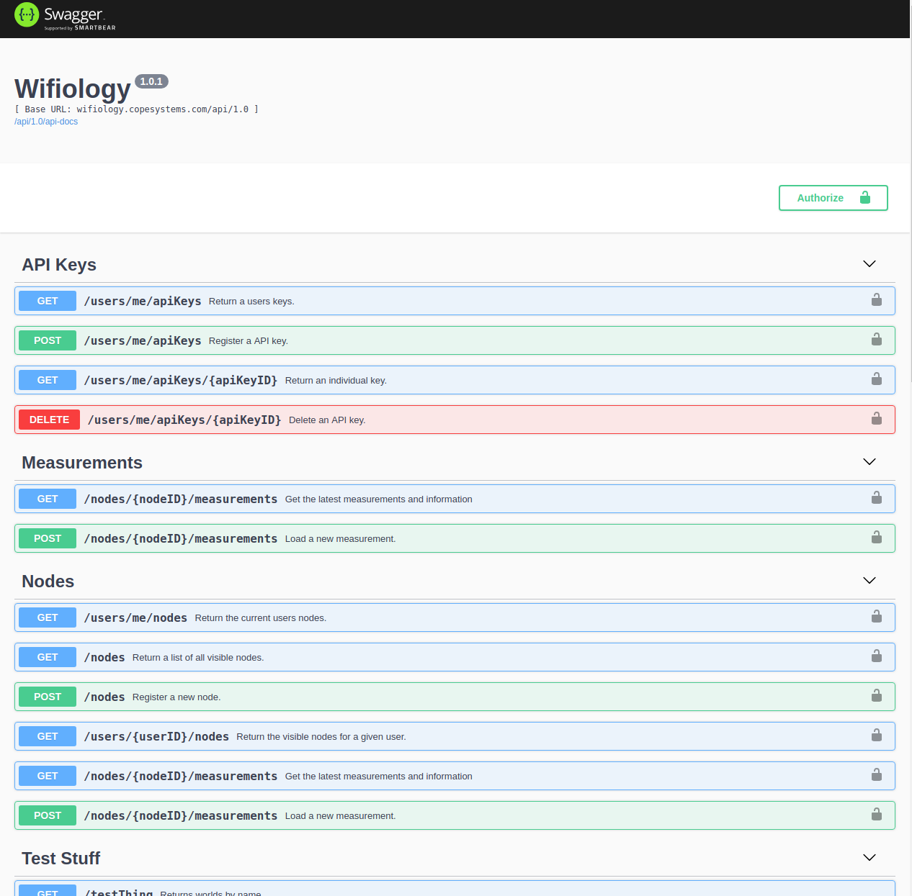
Swagger Spec

Slide 40
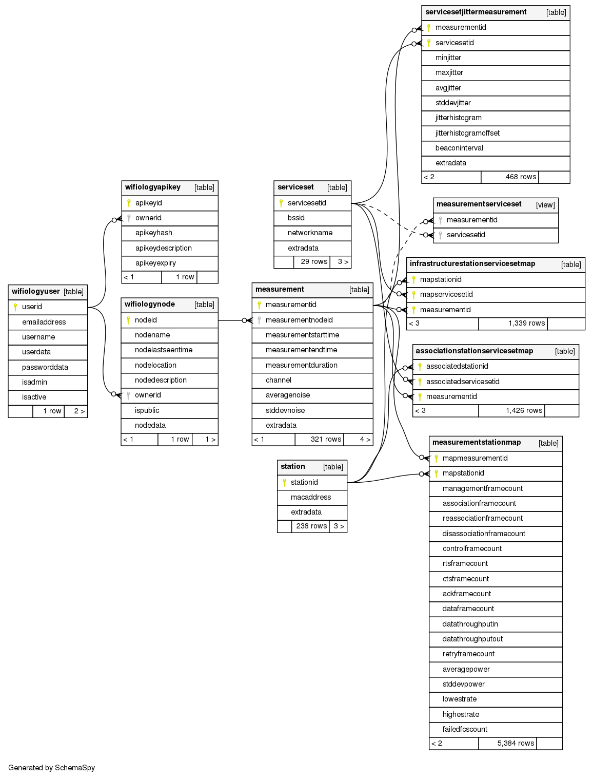
Full PostgreSQL Schema (Huge)

Slide 41
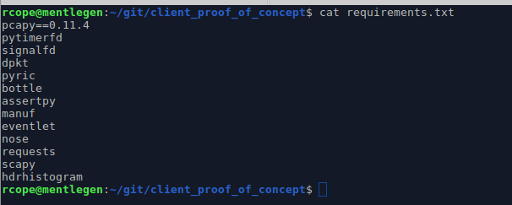
Python

Slide 42
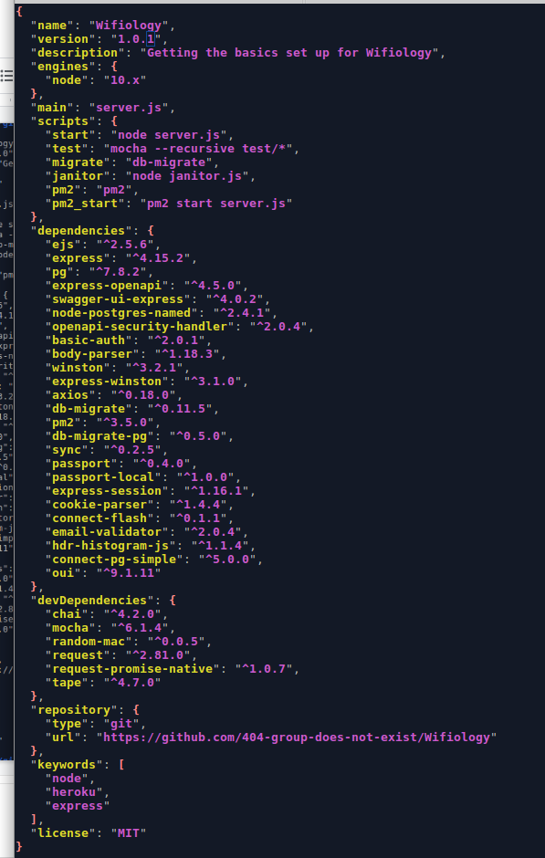
NodeJS

Slide 43

Node.js is Rock Star Tech

